Slide 1
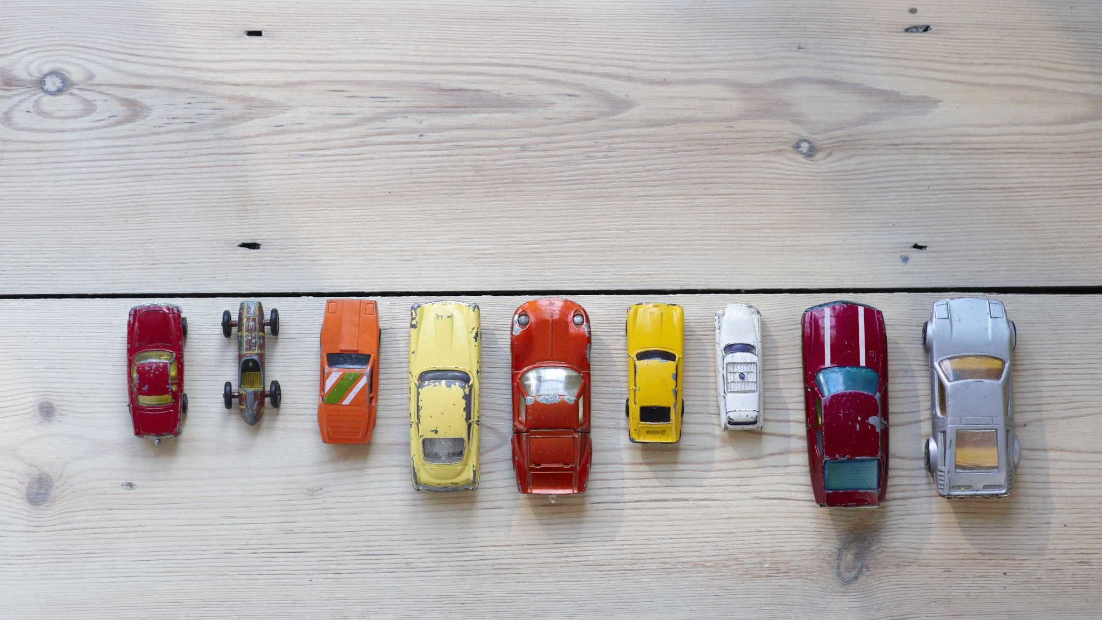
Budget and Environmentally Friendly Car Recommendation System
Sundus Yawar

Slide 2



Non-Technical Overview & Potential Impact
- Not everyone can afford to buy and maintain a hybrid and electric vehicle despite wanting to make environmentally responsible choices
- Cost of living has increased substantially but salaries remain the same, last summer gas prices went up till 217 cents/Litre and this summer they went from 145 cents/Litre to 172 cents/Litre
- Helping users find a car that is both within their budget, is environmentally friendly and cost efficient in terms of fuel can help everyone make an environmentally responsible choice while staying within their budget

Slide 3

Proposed Vision for Tackling the Problem
The data isn’t labeled for whether the cars in the dataset are green or not. However, it has sufficient information for an unsupervised learning model to detect similarities and cluster similar items together, which can help label the data
Unsupervised Machine Learning Technique to cluster the data for best and worst CO2 rating, Smog rating, Combined fuel consumption rating by Make and Vehicle class
Then will explore the data and label the clusters
Build a website that will allow users to select budget range and vehicle class they are interested in and since the data is labeled now thanks to unsupervised machine learning technique (clustering), it will just filter the data based on user input and recommend greener option within budget selected and vehicle class chosen

Slide 4
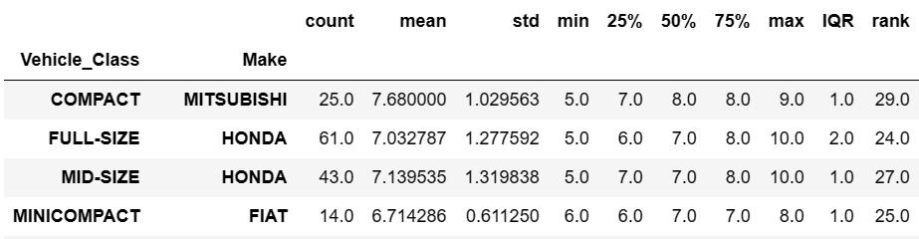
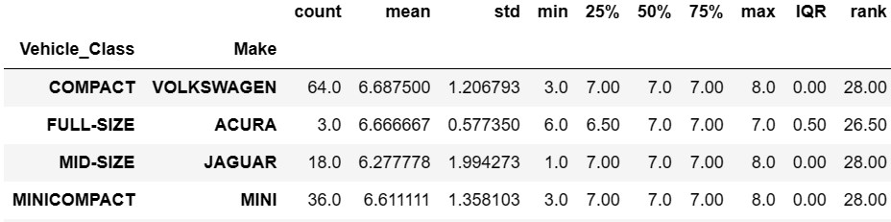
Introduction to the Dataset
6,951 rows and 15 columns
Model_Year | Make | Model | Vehicle_Class | Engine_Size(L) | Cylinders | Transmission | Fuel_Type | Fuel_Consumption-City(L/100 km) | Fuel_Consumption-Hwy(L/100 km) | Fuel_Consumption-Comb(L/100 km) | Fuel_Consumption-Comb(mpg) | CO2_Emissions(g/km) | CO2_Rating | Smog_Rating
Model_Year | Make | Model | Vehicle_Class | Engine_Size(L) | Cylinders | Transmission | Fuel_Type | Fuel_Consumption-City(L/100 km) | Fuel_Consumption-Hwy(L/100 km) | Fuel_Consumption-Comb(L/100 km) | CO2_Emissions(g/km) | CO2_Rating | Smog_Rating | Price
- Prices data was brought in from other datasets, some of them included Price by Make, Model, Year and Mileage so I grouped by the 3 columns and took average then joined the grouped data with the main dataset.
- Found data quality issues in the prices dataset where prices for cars were in 100s and the mileage wasn’t even > 10,000. The cars in the dataset were from 2017-2020.
For each Vehicle Class: Top Make for CO2_Rating
For each Vehicle Class: Top Make for Smog_Rating

Slide 5
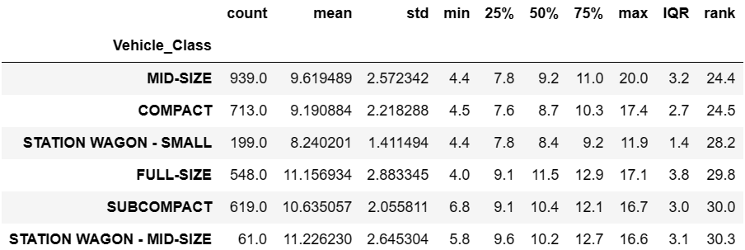
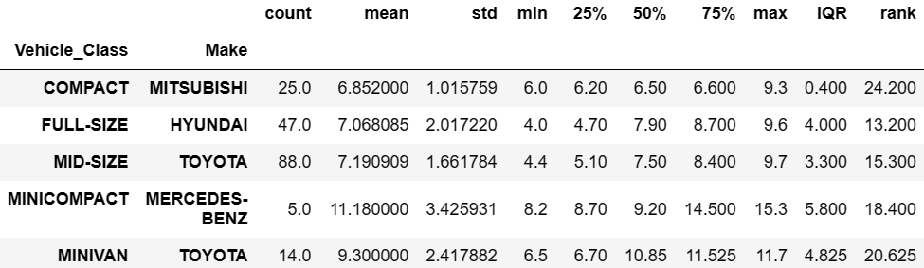
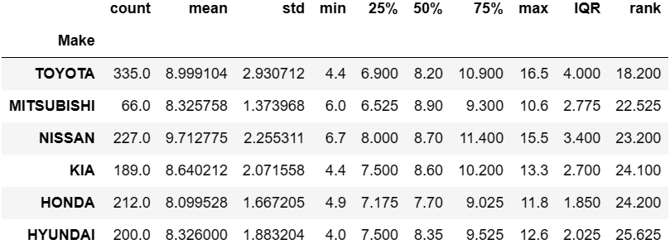
Introduction to the Dataset
Top 5 Vehicle Classes for Fuel Efficiency
For each Vehicle Class: Top Make for Fuel Efficiency
Top 5 Makes for Fuel Efficiency

Slide 6
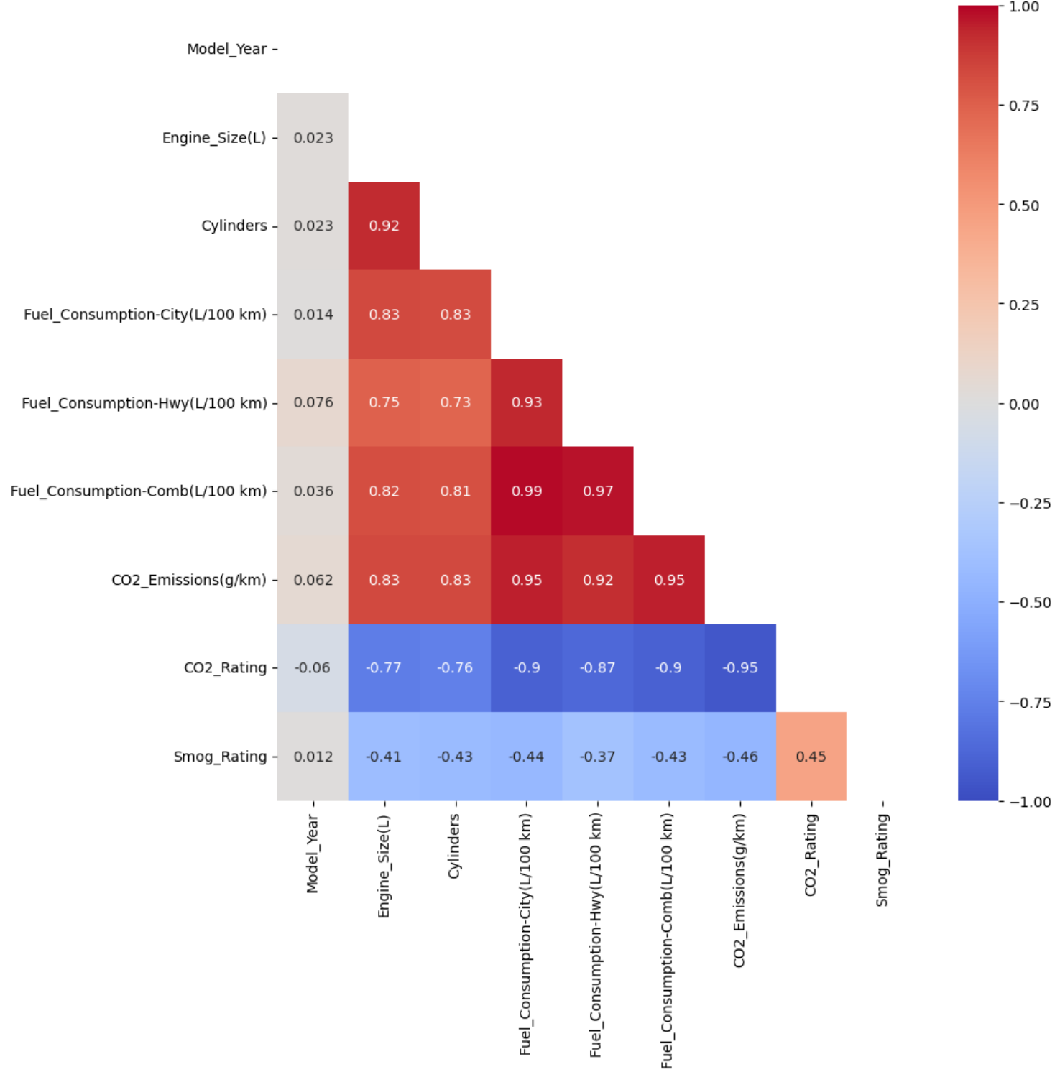
Next Steps
Model_Year | Make | Model | Vehicle_Class | Engine_Size(L) | Cylinders | Transmission | Fuel_Type | Fuel_Consumption-City(L/100 km) | Fuel_Consumption-Hwy(L/100 km) | Fuel_Consumption-Comb(L/100 km) | CO2_Emissions(g/km) | CO2_Rating | Smog_Rating | Price
Data Processing And Feature Engineering:
One hot encoding for Make, Transmission, and Fuel Type
Determine any relationship between Transmission, Fuel with CO2 Emissions, Smog Rating and Combine Fuel Consumption
If there is no relevance for transmission then remove that column
One hot encoding can lead to dimensionality issues, so will need to handle that if it appears
# of Columns including Transmission: 40 + 26 + 5 + (15-5-3) = 78
# of Columns excluding Transmission: 40 + 5 + (15-5-3) = 52
Remove the columns in yellow due to correlations heatmap results
Use KNN (K-Nearest Neighbours) to impute missing values for Prices because the datasets I gathered didn’t have sufficient data to add Prices for all the Make, Model and Year cars
Baseline Modeling:
K-Means clustering algorithm
Simple to implement
Computationally efficient for moderately sized dataset
Easy interpretations as it assigns each data point to the nearest cluster center

